Slide 1
The Design of the Tax System
© 2015 Cengage Learning. All Rights Reserved. May not be copied, scanned, or duplicated, in whole or in part, except for use as permitted in a license distributed with a certain product or service or otherwise on a password-protected website for classroom use.

Slide 2
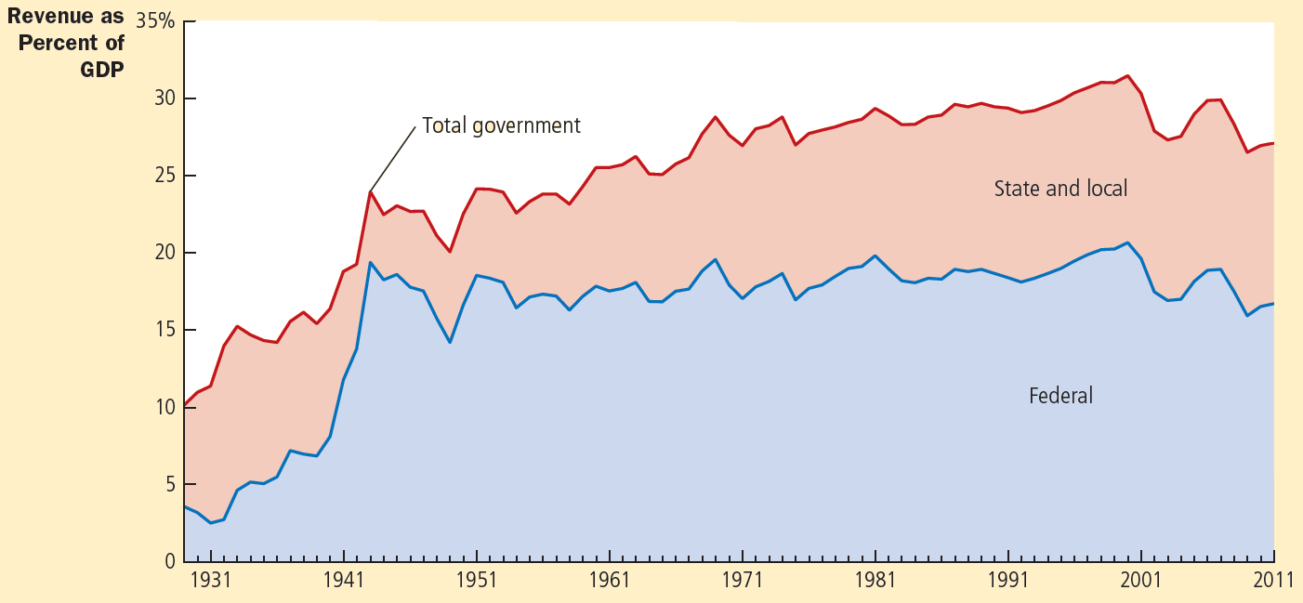
Figure 1
Government Revenue as a Percentage of GDP
This figure shows revenue of the federal government and of state and local governments as a percentage of gross domestic product (GDP), which measures total income in the economy. It shows that the government plays a large role in the U.S. economy and that its role has grown over time.
© 2015 Cengage Learning. All Rights Reserved. May not be copied, scanned, or duplicated, in whole or in part, except for use as permitted in a license distributed with a certain product or service or otherwise on a password-protected website for classroom use.

Slide 3
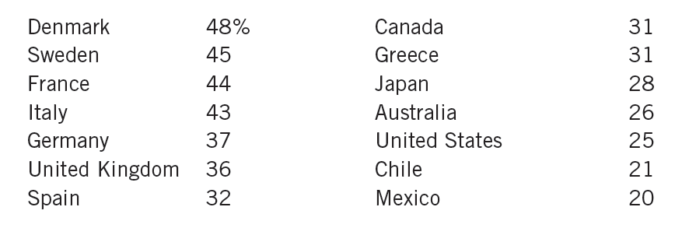

Table 1
Total Government Tax Revenue as a Percentage of GDP
© 2015 Cengage Learning. All Rights Reserved. May not be copied, scanned, or duplicated, in whole or in part, except for use as permitted in a license distributed with a certain product or service or otherwise on a password-protected website for classroom use.

Slide 4
Financial Overview of Government
Government revenue - increased
  As percentage of total income
  As economy’s income has grown
    Government’s revenue from taxation has grown even more
As a nation gets richer
  Government - takes a larger share of income in taxes
© 2015 Cengage Learning. All Rights Reserved. May not be copied, scanned, or duplicated, in whole or in part, except for use as permitted in a license distributed with a certain product or service or otherwise on a password-protected website for classroom use.

Slide 5
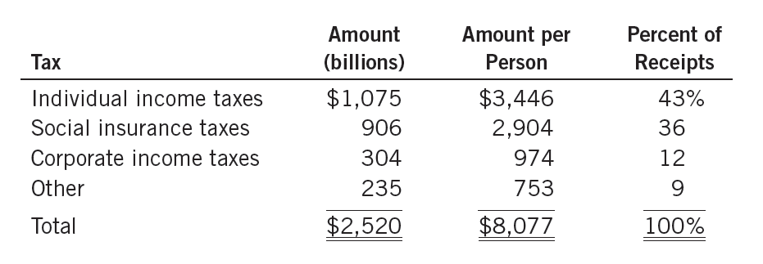

Table 2
Receipts of the Federal Government: 2011
© 2015 Cengage Learning. All Rights Reserved. May not be copied, scanned, or duplicated, in whole or in part, except for use as permitted in a license distributed with a certain product or service or otherwise on a password-protected website for classroom use.

Slide 6
The Federal Government
The federal government’s receipts, 2011
  $2,520 billion ($8,077 per person)
  Individual income tax
    Largest source of revenue
    Based on total income
      Wages, interest, dividends, profits
    Marginal tax rate
      Tax rate applied to each additional dollar of income
      Rises as income rises, higher-income families pay a larger percentage of their income in taxes
© 2015 Cengage Learning. All Rights Reserved. May not be copied, scanned, or duplicated, in whole or in part, except for use as permitted in a license distributed with a certain product or service or otherwise on a password-protected website for classroom use.

Slide 7
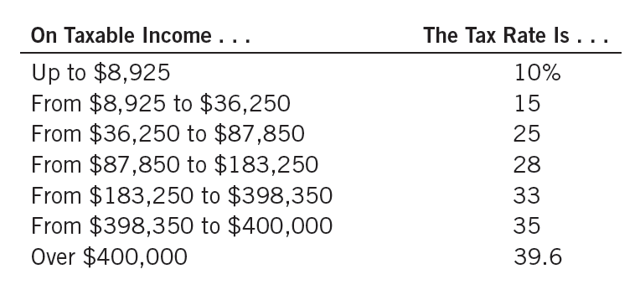
Table 3
The Federal Income Tax Rates: 2013
This table shows the marginal tax rates for an unmarried taxpayer. The taxes owed by a taxpayer depend on all the marginal tax rates up to his income level. For example, a taxpayer with income of $25,000 pays 10 percent of the first $8,925 of income, and then 15 percent of the rest.
© 2015 Cengage Learning. All Rights Reserved. May not be copied, scanned, or duplicated, in whole or in part, except for use as permitted in a license distributed with a certain product or service or otherwise on a password-protected website for classroom use.

Slide 8
The Federal Government
The federal government’s receipts, 2011
  Payroll tax: a tax on the wages that a firm pays its workers
    “Social insurance taxes” – pay for Social Security and Medicare
    Social Security: income-support program for the elderly
    Medicare: government health program for the elderly
© 2015 Cengage Learning. All Rights Reserved. May not be copied, scanned, or duplicated, in whole or in part, except for use as permitted in a license distributed with a certain product or service or otherwise on a password-protected website for classroom use.

Slide 9
The Federal Government
The federal government’s receipts, 2011
  Corporate income tax
    Corporation: business set up to have its own legal existence
    Tax on profits
    Corporate profits are taxed twice
      Corporate income tax when the corporation earns the profits
      Individual income tax when the corporation uses its profits to pay dividends to its shareholders
© 2015 Cengage Learning. All Rights Reserved. May not be copied, scanned, or duplicated, in whole or in part, except for use as permitted in a license distributed with a certain product or service or otherwise on a password-protected website for classroom use.

Slide 10
The Federal Government
The federal government’s receipts, 2011
  Other
    Excise taxes
      Taxes on specific goods like gasoline, cigarettes, and alcoholic beverages
    Estate taxes
    Customs duties
© 2015 Cengage Learning. All Rights Reserved. May not be copied, scanned, or duplicated, in whole or in part, except for use as permitted in a license distributed with a certain product or service or otherwise on a password-protected website for classroom use.

Slide 11
The Federal Government
The federal government’s spending, 2011
  $3,757 billion ($12,042 per person)
  Income security (1/3 of spending)
    A variety of transfer payments
      Government payment not made in exchange for a good or service
      Social Security
      Unemployment insurance payments
      Welfare payments to the poor
© 2015 Cengage Learning. All Rights Reserved. May not be copied, scanned, or duplicated, in whole or in part, except for use as permitted in a license distributed with a certain product or service or otherwise on a password-protected website for classroom use.

Slide 12
The Federal Government
The federal government’s spending, 2011
  Health programs (1/4 of spending)
    Medicare: the government’s health plan for the elderly
    Medicaid: federal health program for the poor
    Medical research (National Institutes of Health
  National defense
    Salaries of military personnel
    Purchases of military equipment
© 2015 Cengage Learning. All Rights Reserved. May not be copied, scanned, or duplicated, in whole or in part, except for use as permitted in a license distributed with a certain product or service or otherwise on a password-protected website for classroom use.

Slide 13
The Federal Government
The federal government’s spending, 2011
  Net interest
    Government borrowing from the public
  Others
    The federal court system
    The space program
    Farm-support programs
    Housing credit programs
    Salaries of members of Congress and the president
© 2015 Cengage Learning. All Rights Reserved. May not be copied, scanned, or duplicated, in whole or in part, except for use as permitted in a license distributed with a certain product or service or otherwise on a password-protected website for classroom use.

Slide 14
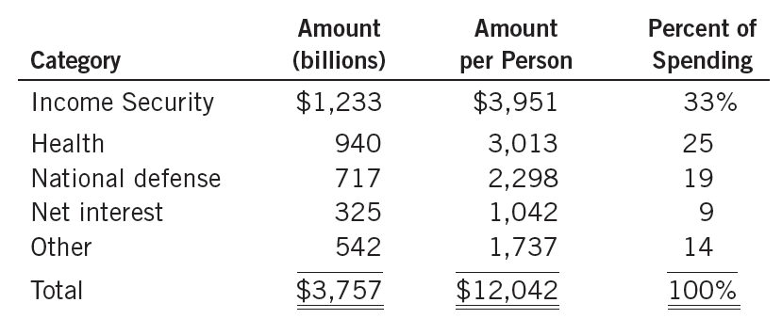

Table 4
Spending of the Federal Government: 2011
© 2015 Cengage Learning. All Rights Reserved. May not be copied, scanned, or duplicated, in whole or in part, except for use as permitted in a license distributed with a certain product or service or otherwise on a password-protected website for classroom use.

Slide 15
The Federal Government
Budget deficit
  Excess of government spending over government receipts
  Financed: borrowing from the public
Budget surplus
  Excess of government receipts over government spending
  Uses the excess receipts to reduce its outstanding debts
© 2015 Cengage Learning. All Rights Reserved. May not be copied, scanned, or duplicated, in whole or in part, except for use as permitted in a license distributed with a certain product or service or otherwise on a password-protected website for classroom use.

Slide 16
The fiscal challenge ahead
2009 to 2012, U.S. federal government
  Budget deficits that exceeded $1 trillion every year
    Largest budget shortfalls since World War II
    Due to the deep recession
    As the economy started to recover, the budget deficit started to shrink
© 2015 Cengage Learning. All Rights Reserved. May not be copied, scanned, or duplicated, in whole or in part, except for use as permitted in a license distributed with a certain product or service or otherwise on a password-protected website for classroom use.

Slide 17
The fiscal challenge ahead
Long-term projections, under current law
  Government will spend vastly more than it will receive in tax revenue
  Taxes: constant (as percentage of GDP)
  Government spending: projected to rise substantially (as percentage of GDP)
© 2015 Cengage Learning. All Rights Reserved. May not be copied, scanned, or duplicated, in whole or in part, except for use as permitted in a license distributed with a certain product or service or otherwise on a password-protected website for classroom use.

Slide 18
The fiscal challenge ahead
Rise in government spending
  Social Security and Medicare
    Significant benefits for the elderly
      The elderly: growing percentage of overall population
      Medical advances and lifestyle improvements
        Increased life expectancy
    Fewer children, smaller families
      Labor force: growing more slowly
      Fewer workers paying taxes to support the government benefits that each elderly person receives
© 2015 Cengage Learning. All Rights Reserved. May not be copied, scanned, or duplicated, in whole or in part, except for use as permitted in a license distributed with a certain product or service or otherwise on a password-protected website for classroom use.

Slide 19
The fiscal challenge ahead
Rise in government spending
  Rising cost of healthcare
    Medicare – healthcare to the elderly
    Medicaid – healthcare to the poor
    Health insurance reform, 2010
      Subsidies for health insurance to many families with low to moderate incomes
© 2015 Cengage Learning. All Rights Reserved. May not be copied, scanned, or duplicated, in whole or in part, except for use as permitted in a license distributed with a certain product or service or otherwise on a password-protected website for classroom use.

Slide 20
The fiscal challenge ahead
Policymakers: stem the rise in healthcare costs
  Reduce the burden of lawsuits on the healthcare system
  Encourage more competition among healthcare providers
  Promote greater use of information technology
  Provide better incentives to doctors to choose more cost-effective treatments
© 2015 Cengage Learning. All Rights Reserved. May not be copied, scanned, or duplicated, in whole or in part, except for use as permitted in a license distributed with a certain product or service or otherwise on a password-protected website for classroom use.

Slide 21
The fiscal challenge ahead
Health economists
  Such measures will have only a limited impact on reducing the government’s healthcare expenditures
  Main reason for rising healthcare costs:
    Medical advances: new, better, but often expensive ways to extend and improve our lives
© 2015 Cengage Learning. All Rights Reserved. May not be copied, scanned, or duplicated, in whole or in part, except for use as permitted in a license distributed with a certain product or service or otherwise on a password-protected website for classroom use.

Slide 22
The fiscal challenge ahead
Handle spending increases
  Increasing budget deficit – not feasible
  Raise taxes as a percentage of GDP
  Reduce the promises now being made to the elderly of the future
  People - encouraged to take a greater role caring for themselves as they age
    Raising the normal retirement age
    People - more incentive to save during their working years
© 2015 Cengage Learning. All Rights Reserved. May not be copied, scanned, or duplicated, in whole or in part, except for use as permitted in a license distributed with a certain product or service or otherwise on a password-protected website for classroom use.

Slide 23
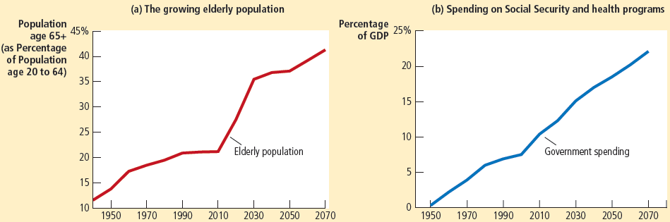

Figure 2
The Demographic and Fiscal Challenge
Panel (a) shows the U.S. population age 65 and older as a percentage of the population age 20 to 64. The growing elderly population will put increasing pressure on the government budget. Panel (b) shows government spending on Social Security and health programs as a percentage of GDP. The projection for future years assumes no change in current law. Unless changes in benefits are enacted, government spending on these programs will rise significantly and will require large tax increases to pay for them.
© 2015 Cengage Learning. All Rights Reserved. May not be copied, scanned, or duplicated, in whole or in part, except for use as permitted in a license distributed with a certain product or service or otherwise on a password-protected website for classroom use.

Slide 24
State and Local Government
State and local governments
  Collect about 40% of all taxes paid
Receipts, 2011
  $2,064 billion ($6,615 per person)
  More than 40% of receipts are from sales taxes and property taxes
  Sales tax
    Percentage of total amount spent at retail stores
© 2015 Cengage Learning. All Rights Reserved. May not be copied, scanned, or duplicated, in whole or in part, except for use as permitted in a license distributed with a certain product or service or otherwise on a password-protected website for classroom use.

Slide 25
State and Local Government
Receipts, 2011
  Property taxes
    Percentage of estimated value of land and structures - paid by property owners
  Individual and corporate income taxes
© 2015 Cengage Learning. All Rights Reserved. May not be copied, scanned, or duplicated, in whole or in part, except for use as permitted in a license distributed with a certain product or service or otherwise on a password-protected website for classroom use.

Slide 26
State and Local Government
Receipts, 2011
  Funds from the federal government
    Redistributes funds from high-income states (which pay more taxes) to low-income states (which receive more benefits)
  Other receipts
    Fees for fishing and hunting licenses;
    Tolls from roads and bridges
    Fares for public buses and subways
© 2015 Cengage Learning. All Rights Reserved. May not be copied, scanned, or duplicated, in whole or in part, except for use as permitted in a license distributed with a certain product or service or otherwise on a password-protected website for classroom use.

Slide 27
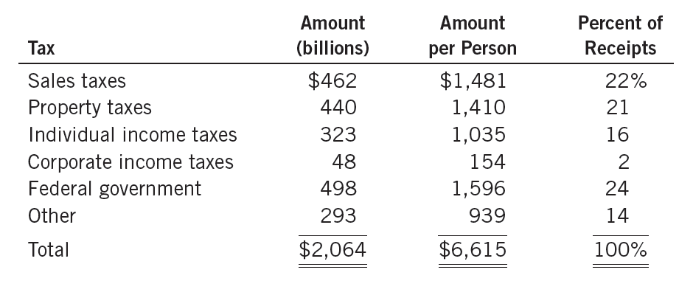

Table 5
Receipts of State and Local Governments: 2011
© 2015 Cengage Learning. All Rights Reserved. May not be copied, scanned, or duplicated, in whole or in part, except for use as permitted in a license distributed with a certain product or service or otherwise on a password-protected website for classroom use.

Slide 28
State and Local Government
Spending, 2011
  $2,166 billion ($6,942 per person)
  Education (1/3 of spending)
    Public schools: kindergarten to high school
    Public universities
  Health programs (Medicaid)
  Public order and safety
    Police, firefighters, courts, and prisons
© 2015 Cengage Learning. All Rights Reserved. May not be copied, scanned, or duplicated, in whole or in part, except for use as permitted in a license distributed with a certain product or service or otherwise on a password-protected website for classroom use.

Slide 29
State and Local Government
Spending, 2011
  Income security programs
  Building and maintenance of roads and highways
  Interest on state and local government debt
  Others
    Libraries, garbage and snow removal
    Maintenance of public parks and playgrounds
© 2015 Cengage Learning. All Rights Reserved. May not be copied, scanned, or duplicated, in whole or in part, except for use as permitted in a license distributed with a certain product or service or otherwise on a password-protected website for classroom use.

Slide 30
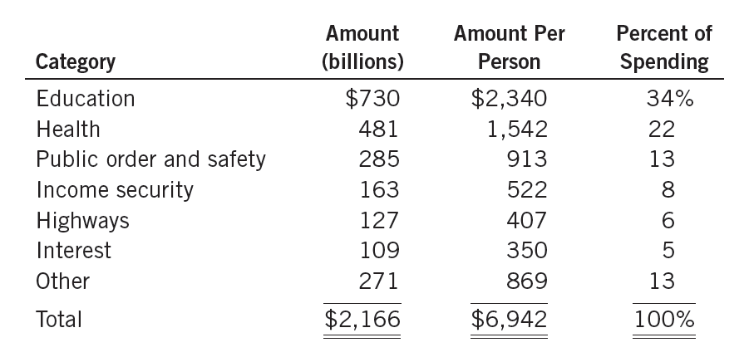

Table 6
Spending of State and Local Governments: 2011
© 2015 Cengage Learning. All Rights Reserved. May not be copied, scanned, or duplicated, in whole or in part, except for use as permitted in a license distributed with a certain product or service or otherwise on a password-protected website for classroom use.

Slide 31
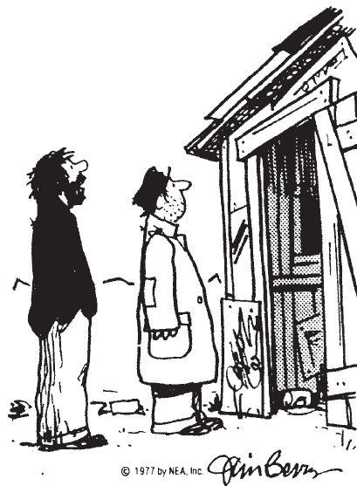
Taxes and Efficiency
Policymakers
  Equity and efficiency
Costs of taxes to taxpayers
  Tax payment itself
  Deadweight losses
    Taxes distort the decisions that people make
  Administrative burdens
    Taxpayers bear as they comply with the tax laws
“I was gonna fix the place up, but if I did, the city would just raise my taxes!”
© 2015 Cengage Learning. All Rights Reserved. May not be copied, scanned, or duplicated, in whole or in part, except for use as permitted in a license distributed with a certain product or service or otherwise on a password-protected website for classroom use.

Slide 32
Taxes and Efficiency
Efficient tax system
  Small deadweight losses
  Small administrative burdens
Deadweight losses
  People respond to incentives
  Government – tax a good
    People buy less of it
  Taxes – distort incentives
© 2015 Cengage Learning. All Rights Reserved. May not be copied, scanned, or duplicated, in whole or in part, except for use as permitted in a license distributed with a certain product or service or otherwise on a password-protected website for classroom use.

Slide 33
Taxes and Efficiency
Deadweight losses
  Reduction in economic well-being of taxpayers
    In excess of the amount of revenue raised by the government
  Inefficiency
    People allocate resources according to the tax incentive
      Not according to true costs and benefits
© 2015 Cengage Learning. All Rights Reserved. May not be copied, scanned, or duplicated, in whole or in part, except for use as permitted in a license distributed with a certain product or service or otherwise on a password-protected website for classroom use.

Slide 34
Taxes and Efficiency
Tax a good
  Consumer surplus drops
  Tax revenue increases
  Decrease in consumer surplus > increase in tax revenue
  Deadweight loss
© 2015 Cengage Learning. All Rights Reserved. May not be copied, scanned, or duplicated, in whole or in part, except for use as permitted in a license distributed with a certain product or service or otherwise on a password-protected website for classroom use.

Slide 35
Should income or consumption be taxed?
Taxes - induce people to change their behavior
  Deadweight losses
  Less efficient allocation of resources
Current tax system: Individual income tax
  Tax the amount of income people earn
  Discourages people from working as hard
  Discourages people from saving
© 2015 Cengage Learning. All Rights Reserved. May not be copied, scanned, or duplicated, in whole or in part, except for use as permitted in a license distributed with a certain product or service or otherwise on a password-protected website for classroom use.

Slide 36
Should income or consumption be taxed?
Changing the basis of taxation
  Eliminate disincentive toward saving
  Consumption tax
    Tax the amount that people spend
    Income saved - not be taxed until the saving is later spent
    Not distort people’s saving decisions
© 2015 Cengage Learning. All Rights Reserved. May not be copied, scanned, or duplicated, in whole or in part, except for use as permitted in a license distributed with a certain product or service or otherwise on a password-protected website for classroom use.

Slide 37
Should income or consumption be taxed?
European countries
  Rely more on consumption taxes than does the US
  Value-added tax (VAT)
    Tax is collected in stages as the good is being produced
© 2015 Cengage Learning. All Rights Reserved. May not be copied, scanned, or duplicated, in whole or in part, except for use as permitted in a license distributed with a certain product or service or otherwise on a password-protected website for classroom use.

Slide 38
Taxes and Efficiency
Administrative burden
  Time spent to fill out forms
  Time spent throughout the year keeping records for tax purposes
  Resources the government has to use to enforce the tax laws
  Tax lawyers and accountants
    Legal tax avoidance
© 2015 Cengage Learning. All Rights Reserved. May not be copied, scanned, or duplicated, in whole or in part, except for use as permitted in a license distributed with a certain product or service or otherwise on a password-protected website for classroom use.

Slide 39
Taxes and Efficiency
Administrative burden
  Resources devoted to complying with tax laws
    Deadweight loss
  Can be reduced – simplify the tax laws
    Politically difficult
© 2015 Cengage Learning. All Rights Reserved. May not be copied, scanned, or duplicated, in whole or in part, except for use as permitted in a license distributed with a certain product or service or otherwise on a password-protected website for classroom use.

Slide 40
Taxes and Efficiency
Average tax rate
  Total taxes paid divided by total income
  Sacrifice made by a taxpayer
    Fraction of income paid in taxes
Marginal tax rate
  The extra taxes paid on an additional dollar of income
  How much tax system distort incentives
  Determines the deadweight loss
© 2015 Cengage Learning. All Rights Reserved. May not be copied, scanned, or duplicated, in whole or in part, except for use as permitted in a license distributed with a certain product or service or otherwise on a password-protected website for classroom use.

Slide 41
Taxes and Efficiency
Lump-sum taxes
  Same amount of tax for every person
  Most efficient tax possible
    A person’s decisions do not alter the amount owed
    Doesn’t distort incentives
    Doesn’t cause deadweight losses
    Imposes a minimal administrative burden
  No equity
© 2015 Cengage Learning. All Rights Reserved. May not be copied, scanned, or duplicated, in whole or in part, except for use as permitted in a license distributed with a certain product or service or otherwise on a password-protected website for classroom use.

Slide 42
Taxes and Equity
The benefits principle
  People should pay taxes based on the benefits they receive from government services
  Tries to make public goods similar to private goods
  A person who gets great benefit from a public good should pay more for it than a person who gets little benefit
© 2015 Cengage Learning. All Rights Reserved. May not be copied, scanned, or duplicated, in whole or in part, except for use as permitted in a license distributed with a certain product or service or otherwise on a password-protected website for classroom use.

Slide 43
Taxes and Equity
The ability-to-pay principle
  Taxes should be levied on a person according to how well that person can shoulder the burden
Vertical equity
  Taxpayers with a greater ability to pay taxes should pay larger amounts
  Richer taxpayers should pay more than poorer taxpayers
© 2015 Cengage Learning. All Rights Reserved. May not be copied, scanned, or duplicated, in whole or in part, except for use as permitted in a license distributed with a certain product or service or otherwise on a password-protected website for classroom use.

Slide 44
Taxes and Equity
Vertical equity
  How much more should the rich pay?
    Proportional tax
      High-income and low-income taxpayers pay the same fraction of income
    Regressive tax
      High-income taxpayers pay a smaller fraction of their income than do low-income taxpayers
    Progressive tax
      High-income taxpayers pay a larger fraction of their income than do low-income taxpayers
© 2015 Cengage Learning. All Rights Reserved. May not be copied, scanned, or duplicated, in whole or in part, except for use as permitted in a license distributed with a certain product or service or otherwise on a password-protected website for classroom use.

Slide 45
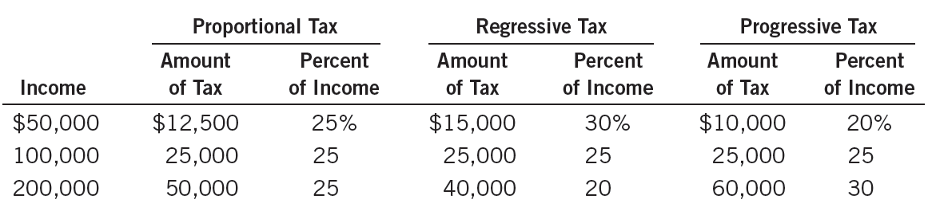
Table 7
Three Tax Systems
© 2015 Cengage Learning. All Rights Reserved. May not be copied, scanned, or duplicated, in whole or in part, except for use as permitted in a license distributed with a certain product or service or otherwise on a password-protected website for classroom use.

Slide 46
How the tax burden is distributed
Do the wealthy pay their fair share of taxes?
United States federal tax system
  Progressive tax system
Families - ranked according to their income
  Five groups of equal size, “quintiles”
© 2015 Cengage Learning. All Rights Reserved. May not be copied, scanned, or duplicated, in whole or in part, except for use as permitted in a license distributed with a certain product or service or otherwise on a password-protected website for classroom use.

Slide 47
How the tax burden is distributed
Income includes
  Market income (earned from work and savings)
  Transfer payments from government programs
Average income
  Poorest quintile: $23,500
  Richest quintile: $223,500
  Richest 1%: over $1.2 million
© 2015 Cengage Learning. All Rights Reserved. May not be copied, scanned, or duplicated, in whole or in part, except for use as permitted in a license distributed with a certain product or service or otherwise on a password-protected website for classroom use.

Slide 48
How the tax burden is distributed
Total taxes as a percentage of income
  Poorest quintile: paid 1.0% of their incomes in taxes
  Richest quintile: paid 23.2%
  Top 1%: paid 28.9% of their incomes
© 2015 Cengage Learning. All Rights Reserved. May not be copied, scanned, or duplicated, in whole or in part, except for use as permitted in a license distributed with a certain product or service or otherwise on a password-protected website for classroom use.

Slide 49
How the tax burden is distributed
Distribution of income and taxes
  Poorest quintile
    Earned 5.1% of all income
    Paid 0.3% of all taxes
  Richest quintile
    Earned 50.8% of all income
    Paid 67.9% of all taxes
  Richest 1%
    Earned 13.4% of all income
    Paid 22.3% of all taxes
© 2015 Cengage Learning. All Rights Reserved. May not be copied, scanned, or duplicated, in whole or in part, except for use as permitted in a license distributed with a certain product or service or otherwise on a password-protected website for classroom use.

Slide 50
How the tax burden is distributed
Transfer payments are the opposite of taxes
  Even greater progressivity
  Richest quintile
    Pays about 25% of income to the government, after transfers
  Poorest quintile
    Receive more in transfers than they pay in taxes
© 2015 Cengage Learning. All Rights Reserved. May not be copied, scanned, or duplicated, in whole or in part, except for use as permitted in a license distributed with a certain product or service or otherwise on a password-protected website for classroom use.

Slide 51
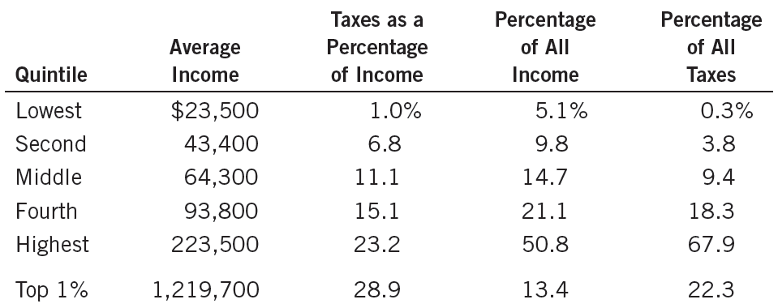

Table 8
The Burden of Federal Taxes
© 2015 Cengage Learning. All Rights Reserved. May not be copied, scanned, or duplicated, in whole or in part, except for use as permitted in a license distributed with a certain product or service or otherwise on a password-protected website for classroom use.

Slide 52
Taxes and Equity
Horizontal equity
  Taxpayers with similar abilities to pay taxes should pay the same amount
  Similar taxpayers
    Determine which differences are relevant for a family’s ability to pay and which differences are not
  U.S. income tax
    Special provisions that alter a family’s tax based on its specific circumstances
© 2015 Cengage Learning. All Rights Reserved. May not be copied, scanned, or duplicated, in whole or in part, except for use as permitted in a license distributed with a certain product or service or otherwise on a password-protected website for classroom use.

Slide 53
Taxes and Equity
Tax incidence
  Who bears the burden of taxes
  Central to evaluating tax equity
  Person who bears the burden a tax
    Not always the person who gets the tax bill from the government
Taxes alter supply and demand
  Alter equilibrium prices
  Indirect effects
© 2015 Cengage Learning. All Rights Reserved. May not be copied, scanned, or duplicated, in whole or in part, except for use as permitted in a license distributed with a certain product or service or otherwise on a password-protected website for classroom use.

Slide 54
Who pays the corporate income tax?
People pay all taxes
Tax on a corporation
  Corporation – more like a tax collector than taxpayer
  Burden of the tax ultimately falls on people
  Workers and customers bear much of the burden of the corporate income tax
  Popular - it appears to be paid by rich corporations
© 2015 Cengage Learning. All Rights Reserved. May not be copied, scanned, or duplicated, in whole or in part, except for use as permitted in a license distributed with a certain product or service or otherwise on a password-protected website for classroom use.

Slide 55

Who pays the corporate income tax?
People pay all taxes
This worker pays part of the corporate income tax.
© 2015 Cengage Learning. All Rights Reserved. May not be copied, scanned, or duplicated, in whole or in part, except for use as permitted in a license distributed with a certain product or service or otherwise on a password-protected website for classroom use.

Slide 56
Trade-off: Equity vs. Efficiency
Equity and efficiency
  The two most important goals of a tax system
  Often conflict
    Especially when equity is judged by the progressivity of the tax system
1980, marginal tax rate
  Richest Americans: 50%
    70% on interest income
© 2015 Cengage Learning. All Rights Reserved. May not be copied, scanned, or duplicated, in whole or in part, except for use as permitted in a license distributed with a certain product or service or otherwise on a password-protected website for classroom use.

Slide 57
Trade-off: Equity vs. Efficiency
Ronald Reagan, president, 1980
  The high tax rates greatly distorted economic incentives to work and save
  Priority: tax reform
  1981 and 1986: large cuts in tax rates
  Left office in 1998; marginal tax rate
    Richest Americans: 28%
© 2015 Cengage Learning. All Rights Reserved. May not be copied, scanned, or duplicated, in whole or in part, except for use as permitted in a license distributed with a certain product or service or otherwise on a password-protected website for classroom use.

Slide 58
Trade-off: Equity vs. Efficiency
1993, President Bill Clinton
  40% marginal tax rate on the richest Americans
President George W. Bush
  35% marginal tax rate
President Barack Obama, 2013
  40% marginal tax rate
© 2015 Cengage Learning. All Rights Reserved. May not be copied, scanned, or duplicated, in whole or in part, except for use as permitted in a license distributed with a certain product or service or otherwise on a password-protected website for classroom use.

